Slide 1
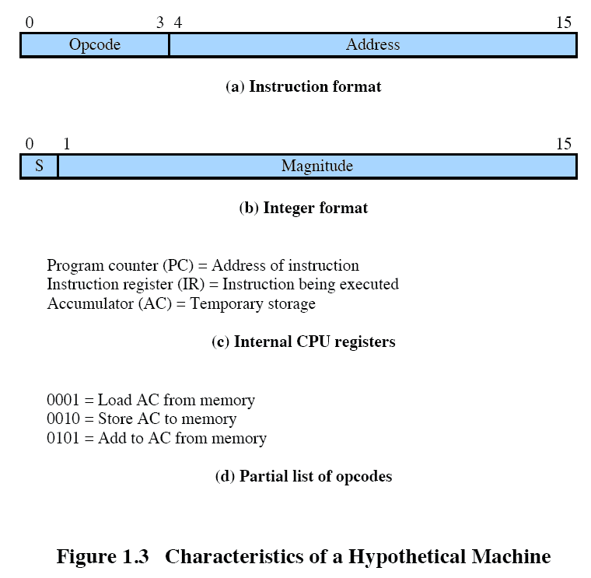
Characteristics of a
Hypothetical Machine
Notes:
Consider a simple example using a hypothetical processor
The processor contains a single data register, called the accumulator (AC).
Both instructions and data are 16 bits long, and memory is organized as a sequence of 16-bit words.
The instruction format provides 4 bits for the opcode, allowing as many as 2⁴ = 16 different opcodes
represented by a single hexadecimal digit.
The opcode defines the operation the processor is to perform.
With the remaining 12 bits of the instruction format, up to 2¹² = 4096 (4 K) words of memory can be directly addressed.
denoted by three hexadecimal digits.

Slide 2
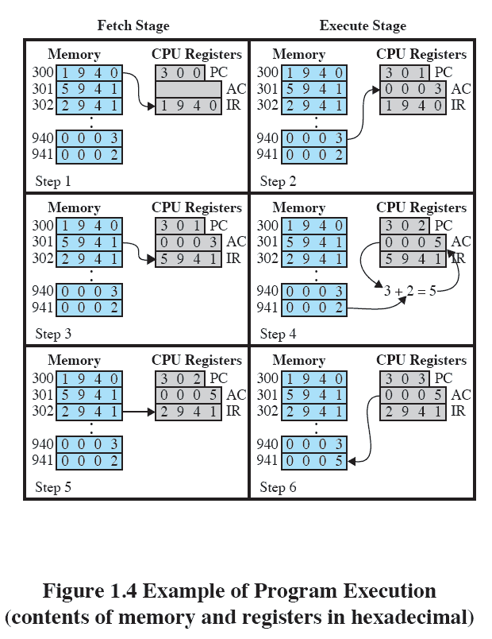
Example of
Program Execution
Notes:
This figure illustrates a partial program execution, showing the relevant portions of memory and processor registers.
The program fragment shown adds the contents of the memory word at address 940 to the contents of the memory word at address 941 and stores the result in the latter location.
Three instructions, which can be described as three fetch and three execute stages, are required:
1. The PC contains 300, the address of the first instruction.
This instruction (the value 1940 in hexadecimal) is loaded into the IR and the PC is incremented.
Note that this process involves the use of a memory address register (MAR) and a memory buffer register (MBR).
For simplicity, these intermediate registers are not shown.
2. The first 4 bits (first hexadecimal digit) in the IR indicate that the AC is to be loaded from memory.
The remaining 12 bits (three hexadecimal digits) specify the address, which is 940.
3. The next instruction (5941) is fetched from location 301 and the PC is incremented.
4. The old contents of the AC and the contents of location 941 are added and the result is stored in the AC.
5. The next instruction (2941) is fetched from location 302 and the PC is incremented.
6. The contents of the AC are stored in location 941.

